Slide 1

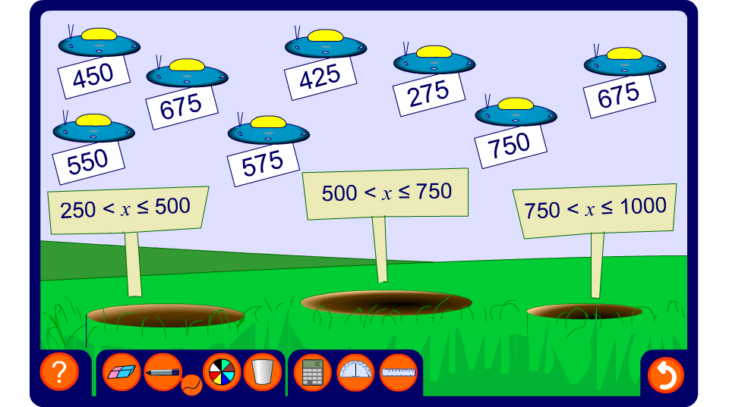


Notation for class intervals
Notes:
This activity involves pupils deciding which class interval a number belongs in. The numbers should be dragged into the right interval.

